Slide 1
Instructing Language Models to Do Reasoning Wisely
Meng Jiang
Department of Computer Science and Engineering
University of Notre Dame

Slide 2
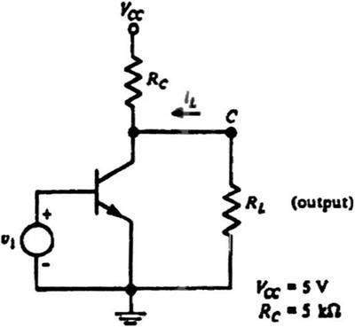
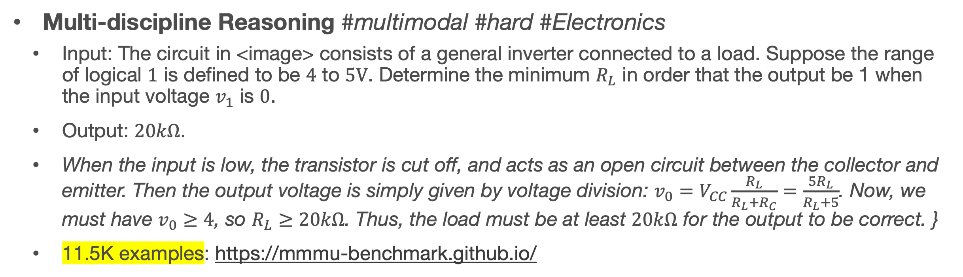
Reasoning in Natural Language
Can we build machines (i.e., language models) to do these tasks?
Math Reasoning
Input: Roger has 5 tennis balls. He buys 2 more cans of tennis balls. Each can has 3 tennis balls. How many tennis balls does he have now?
Output: The answer is 11.
37K examples: https://math-qa.github.io/math-QA/ and many other datasets
Multi-discipline Reasoning #multimodal #hard #Electronics
Input: The circuit in <image> consists of a general inverter connected to a load. Suppose the range of logical $1$ is defined to be $4$ to $5V$. Determine the minimum $R_{L}$ in order that the output be 1 when the input voltage $v_{1}$ is $0$.
Output: $20kΩ$.
When the input is low, the transistor is cut off, and acts as an open circuit between the collector and emitter. Then the output voltage is simply given by voltage division: $v_{0}=V_{CC}\frac{R_{L}}{R_{L}+R_{C}}=\frac{5R_{L}}{R_{L}+5}$. Now, we must have $v_{0}≥4$, so $R_{L}≥20kΩ$. Thus, the load must be at least $20kΩ$ for the output to be correct. }
11.5K examples: https://mmmu-benchmark.github.io/

Slide 3
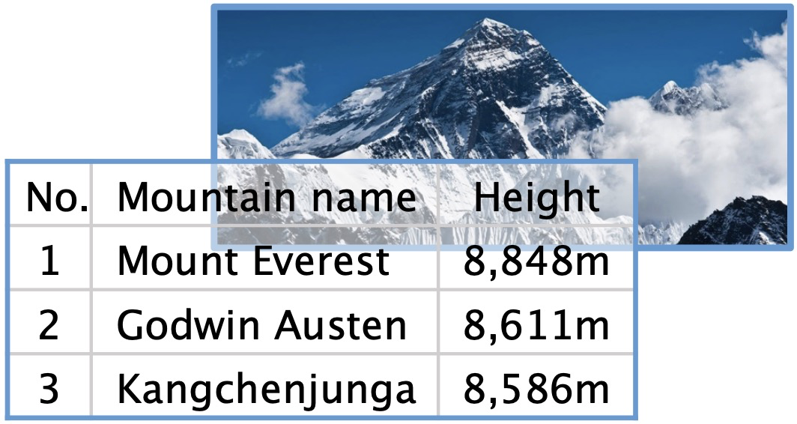
Reasoning in Natural Language (cont.)
Can we build machines (i.e., language models) to do the tasks?
Counterfactual Presupposition
Input: If the movement of the earth’s crust caused the height of Mount Everest to drop by 300 meters, what would be the highest mountain in the world?
Output: K2 (Godwin Austen)
3.8K examples: https://github.com/wyu97/IfQA
Commonsense Reasoning & Abductive Reasoning
More examples and datasets

Slide 4
Multi-choice Commonsense Question Answering
Commonsense Fact Verification
Where can I stand on a river to see water falling without getting wet?
A pound of cotton has the same weight as a pound of steel.
A) waterfall
B) bridge
C) valley
D) stream
E) bottom
True
False
Datasets:
OpenBookQA: Clark et al. arxiv 2018. (5,957 questions)
CommonsenseQA 1.0： Talmor et al. NAACL 2019. (12,102)
Evaluation: Accuracy.
Datasets:
CommonsenseQA 2.0: Talmor et al. (14,343 assertions)
CREAK： Onoe et al. NeurIPS 2021 Benchmark Track. (13,000)
Evaluation: Accuracy.
Constrained Commonsense Generation
Counterfactual Explanation Generation
Constraints: dog, frisbee, catch, throw
I am hungry for water.
Description: A girl throws a frisbee and her dog catches it.
Outputs:
1) Water is used to quench thirsty.
2) You are thirsty for water, not hungry.
3) Water is not food.
Datasets:
CommonGen: Lin et al. Findings of EMNLP 2020. (79,000+ commonsense descriptions)
Evaluation: SPICE, BLEU-4, ROUGE-L, CIDEr.
Datasets:
ComVE: Wang et al. SemEval-2020 Task 4 (11,997 examples)
Evaluation: SPICE, BLEU-4, ROUGE-L, CIDEr.

Slide 5
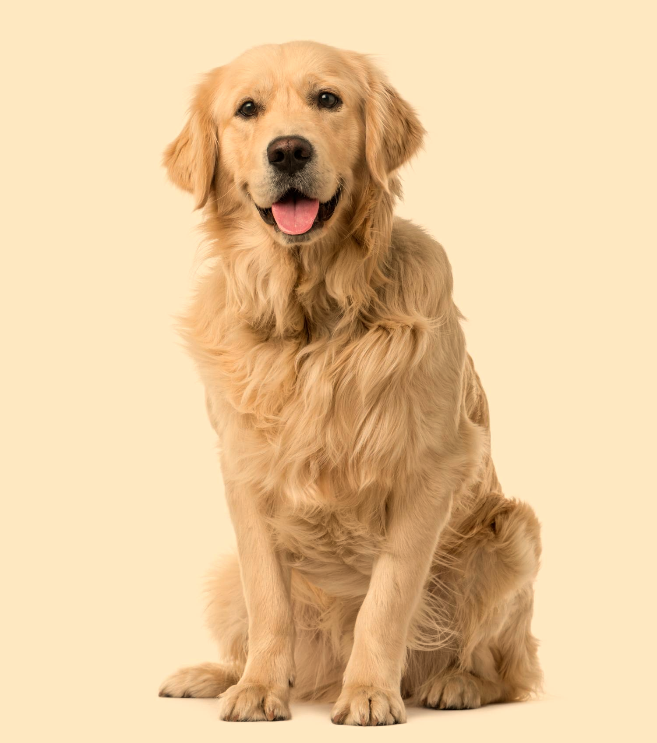
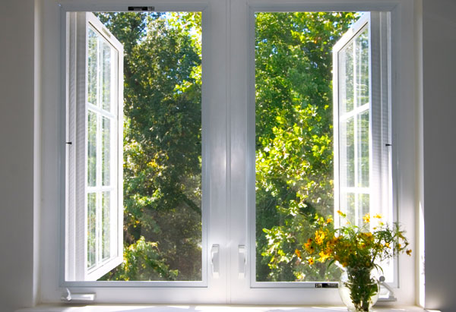
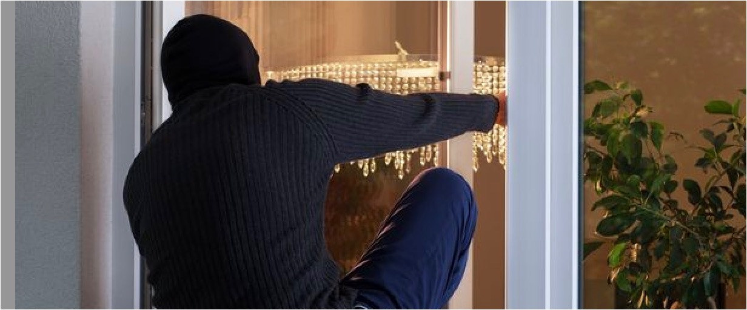
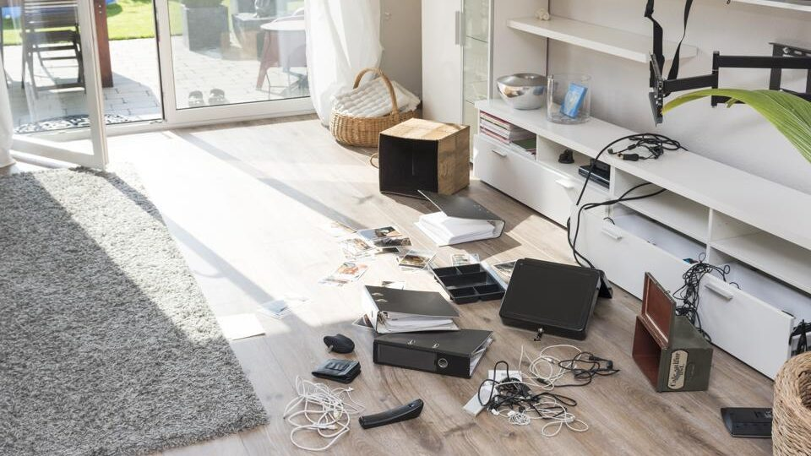
Abductive Reasoning
Cleaned house
Went to work
Leaved windows open
?
All dogs have ears.
Golden retrievers are dogs.
Golden retriever have ears.
Back home
Found a mess
Deductive
Reasoning

Slide 6
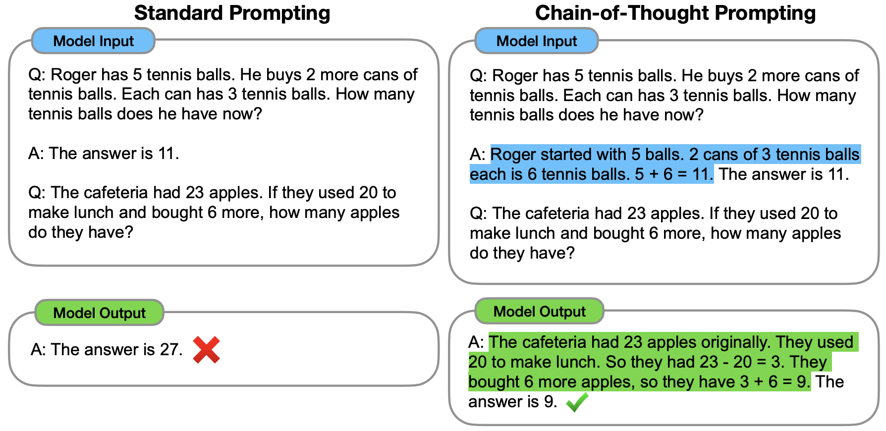
Chain of Thoughts
Known as one of the “Emergent Abilities” of Large Language Models (LLMs)
One-shot learning: “learn” the Q-A pair in model input.
Is it “training”? Does it modify model parameters?
Past (deep) learning models did not show the few-shot learning abilities.
Chain-of-thoughts improves reasoning.
Wei et al. (Google Brain) https://arxiv.org/abs/2201.11903

Slide 7
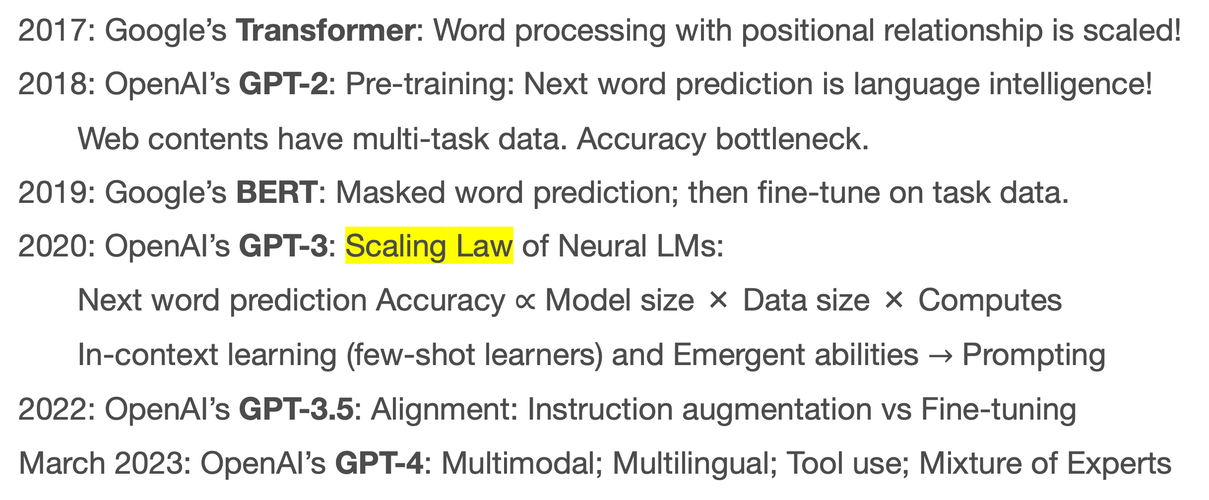
Key Techs Behind LLMs
An Important Part of Chronology in Deep Learning History
2017: Google’s Transformer: Word processing with positional relationship is scaled!
2018: OpenAI’s GPT-2: Pre-training: Next word prediction is language intelligence!
Web contents have multi-task data. Accuracy bottleneck.
2019: Google’s BERT: Masked word prediction; then fine-tune on task data.
2020: OpenAI’s GPT-3: Scaling Law of Neural LMs:
Next word prediction Accuracy ∝ Model size × Data size × Computes
In-context learning (few-shot learners) and Emergent abilities $→$ Prompting
2022: OpenAI’s GPT-3.5: Alignment: Instruction augmentation vs Fine-tuning
March 2023: OpenAI’s GPT-4: Multimodal; Multilingual; Tool use; Mixture of Experts

Slide 8
How does human solve complex reasoning tasks?
Let’s instruct LLMs to do reasoning wisely
by human-like prompting (not training).

Slide 9
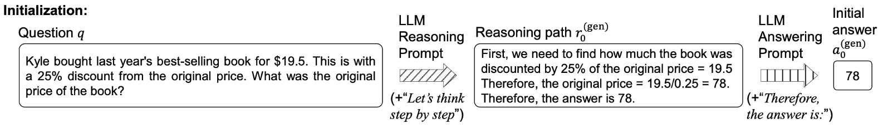
Kyle bought last year’s best-selling book for $19.5. This is with a 25% discount from the original price. What was the original price of the book?
First, we need to find how much the book was discounted by 25% of the original price = 19.5. Therefore, the original price = 19.5/0.25 = 78. Therefore, the answer is 78. ×
19.5 / (1 – 0.25) = 26.
Wu et al. Get an A in Math: Progressive Rectification Prompting (AAAI’24) https://arxiv.org/abs/2312.06867

Slide 10
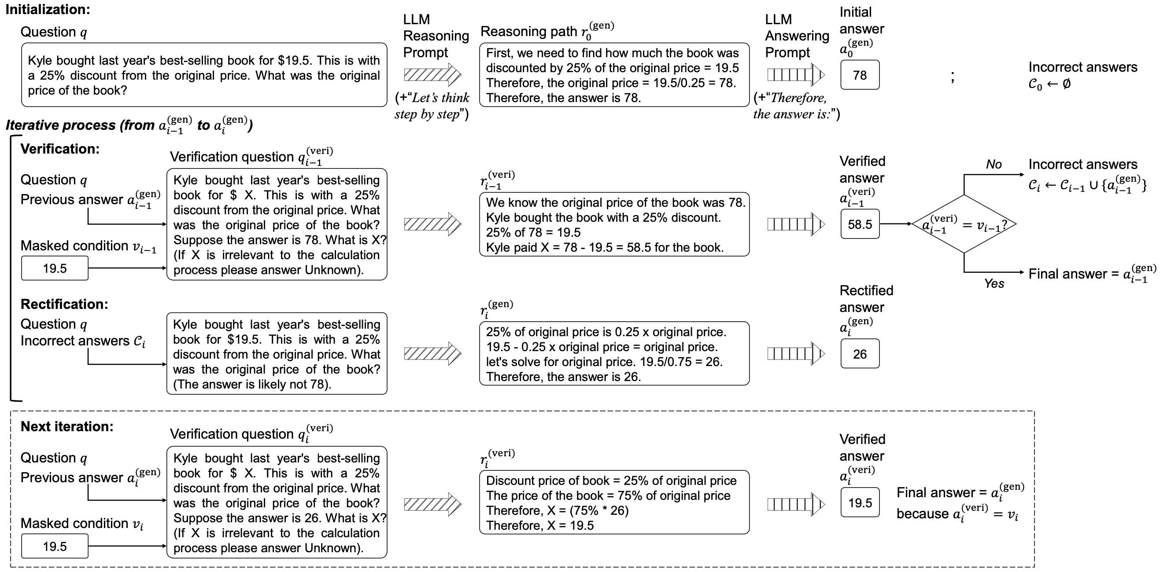
Wu et al. Get an A in Math: Progressive Rectification Prompting (AAAI’24) https://arxiv.org/abs/2312.06867

Slide 11
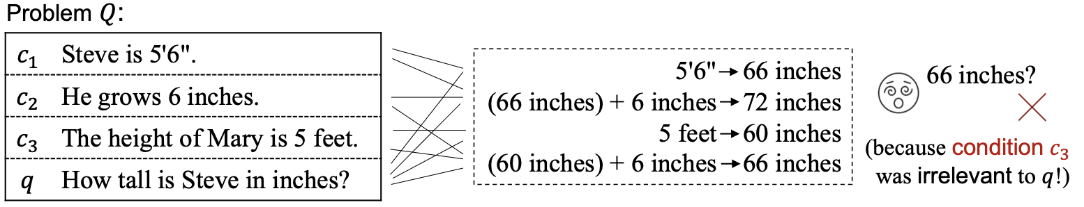
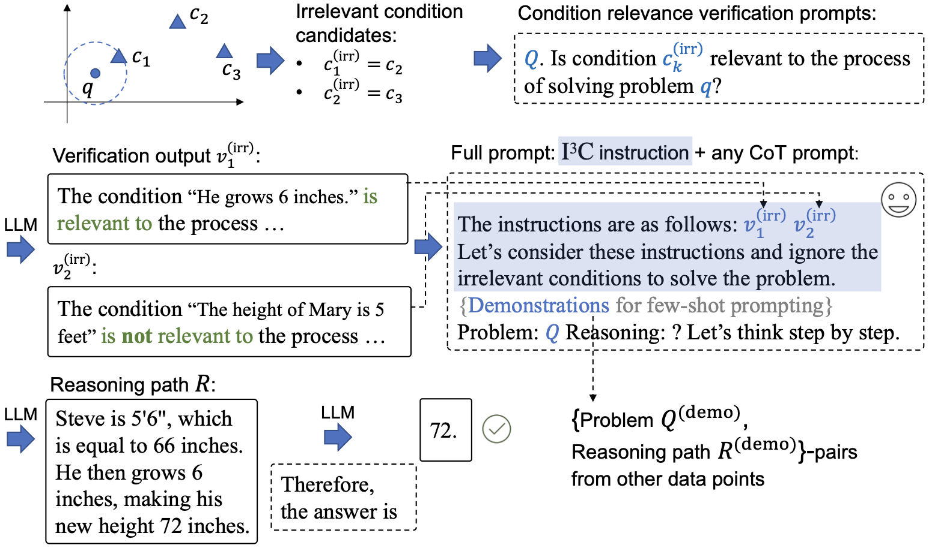
Wu et al. Instructing Large Language Models to Identify and Ignore Irrelevant Conditions.

Slide 12
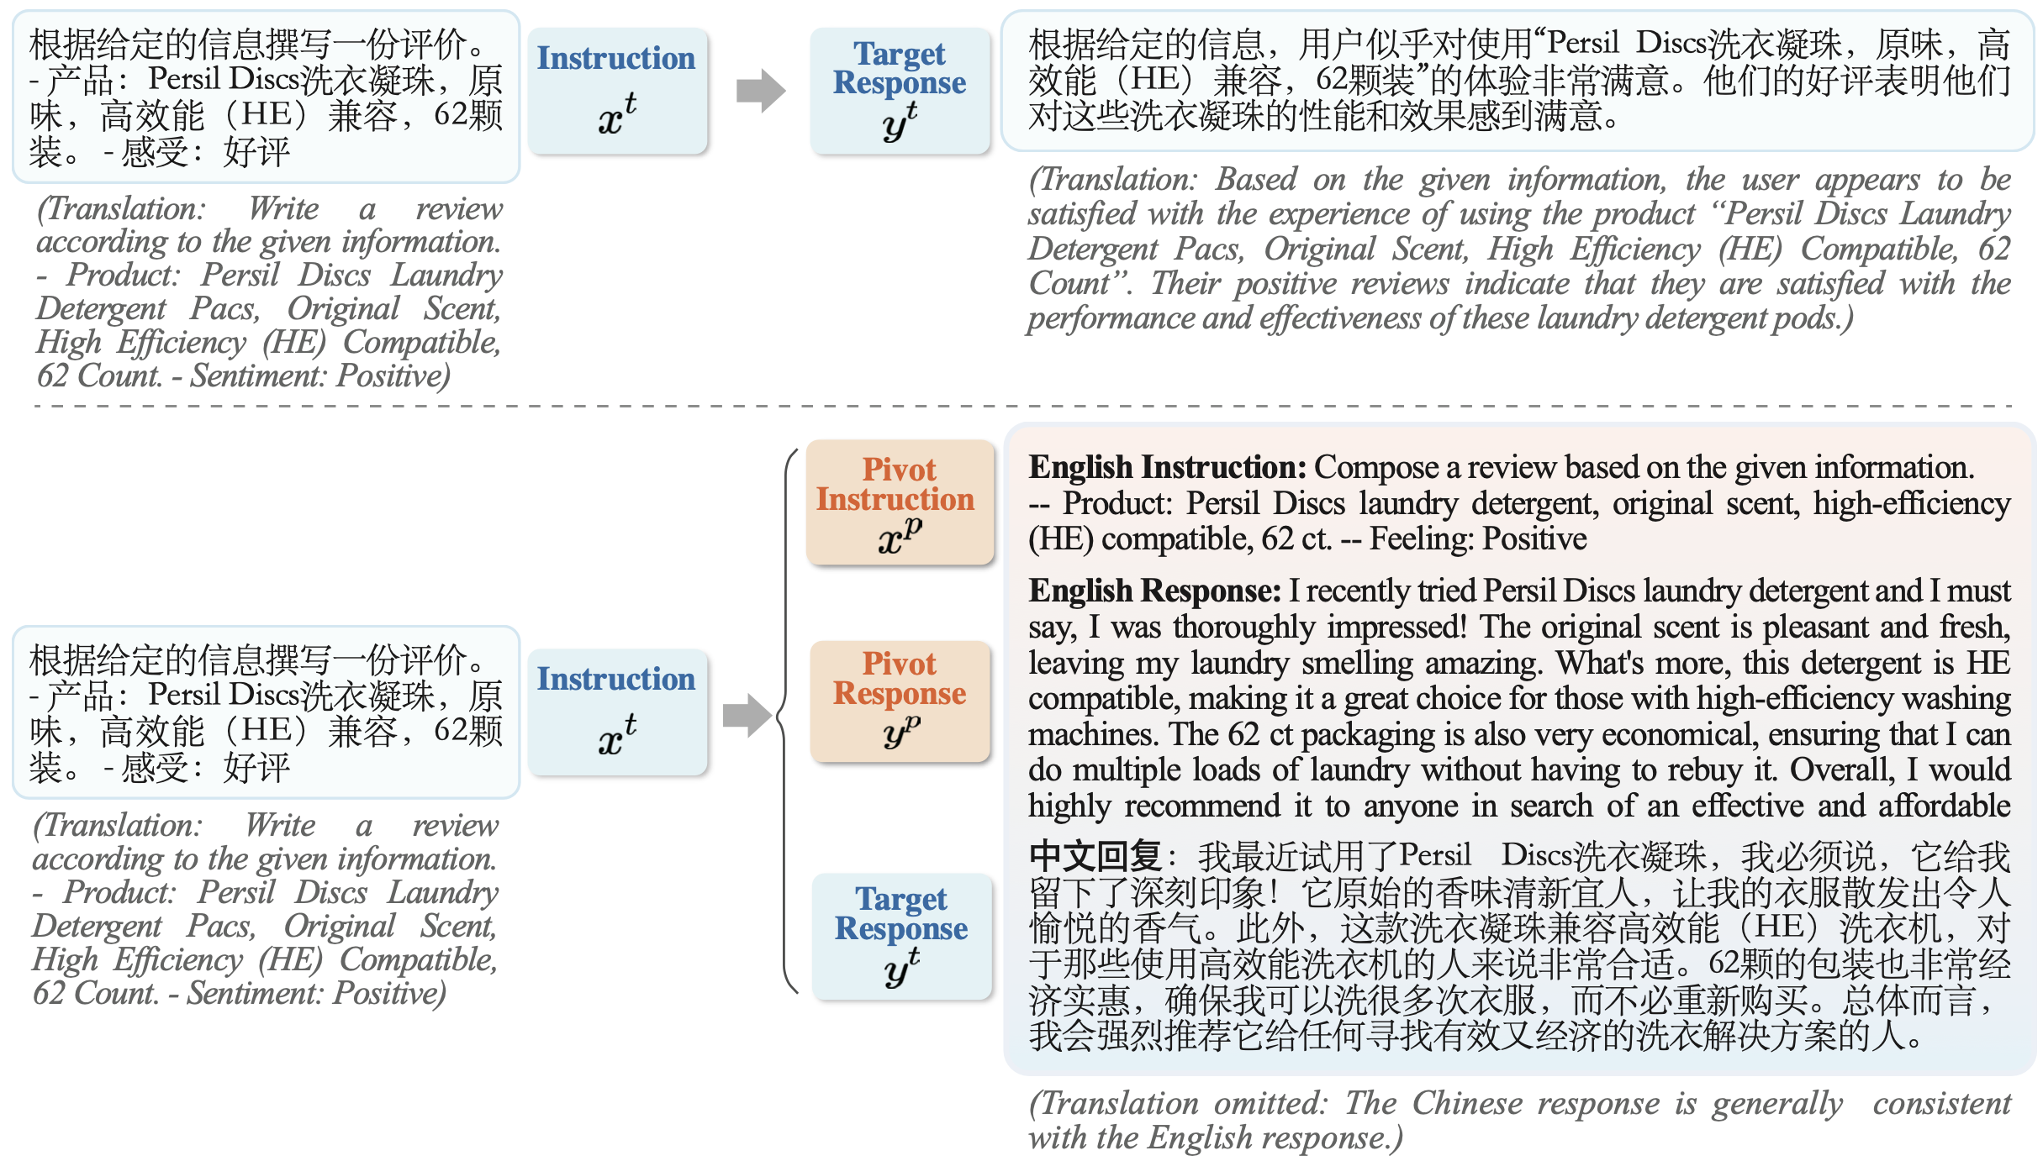
Zhang et al. PLUG: Leveraging Pivot Language in Cross-Lingual Instruction Tuning.

Slide 13
Closed-Book
Open-Book
Large Language Model (LLM)
Knowledge Augmentation
Retrieval-Augmented Generation (RAG)
Pre-collected corpus
Pre-training
175 Billion parameters
(or bigger)
External
knowledge
sources
Wikipedia
News
Database
Social media
…
(self-supervision)
Human feedback
R. L.
Retriever
(~0.12B)
Input (e.g. question)
Output
Input
Knowledge
(e.g., passage)
Output
tasks
tasks
Reader/Generator
(< 0.25B parameters or 175B LLMs)
when will notre dame play michigan state again?

Slide 14
Dense Passage Retriever
Large-Scale
Commonsense
Corpus
Commonsense Benchmark Datasets
Source Heterogeneity
(e.g., transform KG / KB)
Human Annotated Facts
(e.g., Relations, Knowledge Graphs)
Commonsense Relevant Corpus
(e.g., Statements, Knowledge Bases)
Input
Retrieved Passages
Output
Multi-choice Commonsense Question Answering
Commonsense Fact Verification
Constrained Commonsense Generation
Generator
(as classifier if needed)
Counterfactual Explanation Generation
Constraints: dog, frisbee, catch, throw
Description: A girl throws a frisbee and her dog catches it.
Yu et al. Retrieval Augmentation for Commonsense Reasoning: A Unified Approach (EMNLP’22)

Slide 15

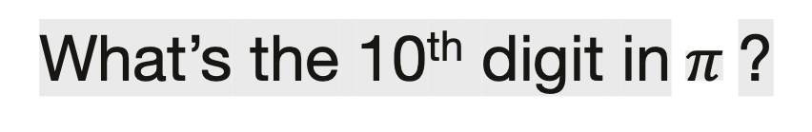
Who got the first Nobel prize in physics?
Who got the first Nobel prize in physics?
“Generate a background document to answer
the given question [Q]:”
“Question: [Q] Answer:”
The first Nobel Prize in Physics was awarded in 1901 to Wilhelm Conrad Rontgen in recognition of the extraordinary services he has rendered by the discovery of the remarkable rays subsequently named after him
GPT-3
(175 Billion parameters)
GPT-3
“Question: [Q]
Passage: [P]
Answer: ”
GPT-3
Albert Einstein.
Wilhelm Conrad Rontgen
What’s the 10th digit in$π$?
Yu et al. Generate rather than Retrieve: Large Language Models are Strong Context Generators (ICLR’23)

Slide 16
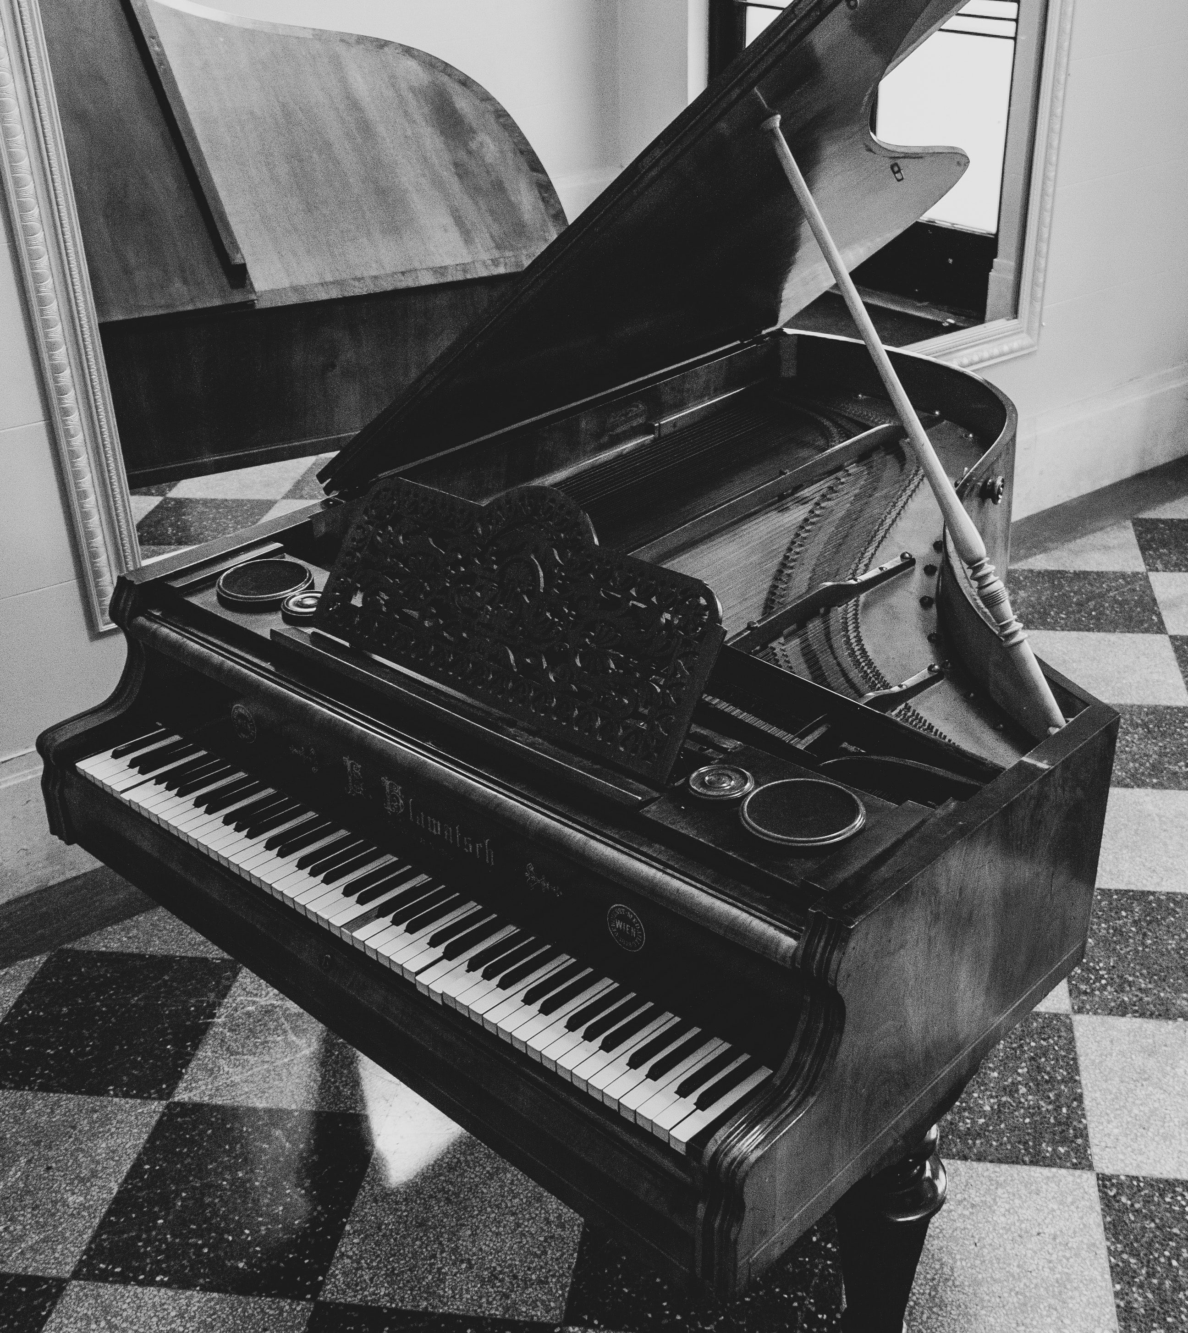
Commonsense Reasoning
Explaining counterfactual statements
Input:
Piano is a kind of sport. This is False because ___________________
Annotators 1 and 4:
you can produce music when pressing keys on the piano, so it is an instrument.
Annotators 3 and 5:
piano is a musical instrument used in songs to produce different musical tones.
Annotator 2:
piano is a kind of art form.

Slide 17
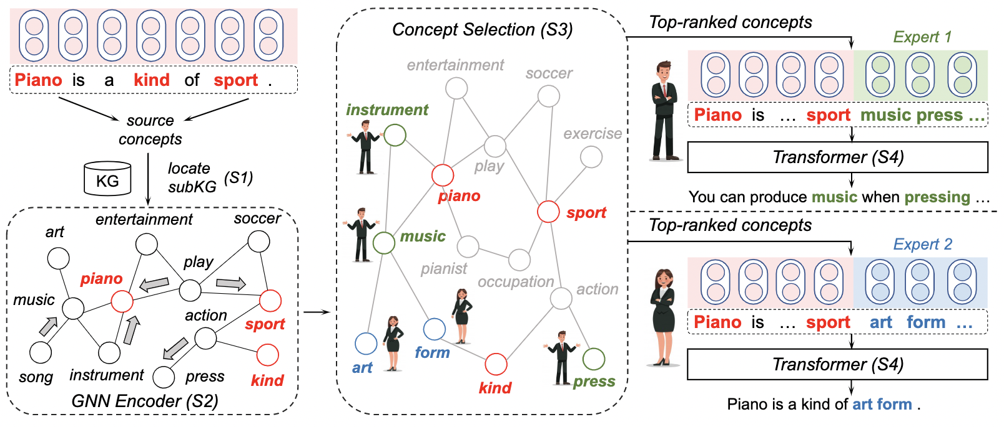
Generating Diverse Explanations
Mixture of Knowledge Graph Experts (MoKGE)
Yu et al. Diversifying Content Generation for Commonsense Reasoning with Mixture of Knowledge Graph Experts (ACL’22)

Slide 18
Take Away
Scaling Law enables in-context learning that instructs (not trains) LLMs to reason.
Prompting: Implement examination skills in prompting for math reasoning
Retrieval-augmented generation: Create an open-book environment.
Many others: Leverage pivot language, Outline for diverse solutions, etc.

Slide 19

Welcome to visit our lab!
http://www.meng-jiang.com/lab.html
https://github.com/DM2-ND
mjiang2@nd.edu
18

